Slide 1

FORMULA 1 HISTORY THROUGH DATA
FEBRUARY 2022

Slide 2




PARTICIPANTS
Sergio Gaytán
Jorge Ponce
Raciel Tavitas
Ricardo Barba

Slide 3

FORMULA 1 – SELECTED TOPIC
The selection of the topic attended to the following reasons:
Long history from the sport,
available statistics from every race,
hard data available (i.e. racing times, number of laps, pit stops, final positions, etc.),
the data is verifiable,
complex and interesting questions to be solved.

Slide 4
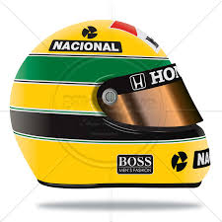
QUESTION TO BE SOLVED
The objective of the project is to display all the relevant data generated from this sport to obtain and understanding of the sport through data analysis for fans and new enthusiasts of the sport.
How relevant is the driver vs the car to determine a race output?
How relevant are the number of pit stops to a race output or winner?
Are mechanical failures significant to determine a race output or winner?
How relevant are the number of pole positions to determine a race output or winner?
Which factors are the determinant to get a F1 race winner?
Identify which other variables could be relevant to affect the result of a race.
.

Slide 5
TECHNOLOGIES AND TOOLS

Slide 6



TECHNOLOGIES
Amazon Web Services
Postgres
Tableau

Slide 7




TOOLS AND LANGUAGES
Github
Jupyter notebook
SQL
Python

Slide 8
DATA SOURCE, EXPLORATION AND PROCESSING

Slide 9



DATABASE PROCESSING
Extract
- Identify data sources
-Verify accuracy
Data exploration and transformation
- Clean data
- Perform preliminary analysis
- Calculate relevant data
- Create data frames
Load
- Load data to Postgress
- Integrate data for processing

Slide 10
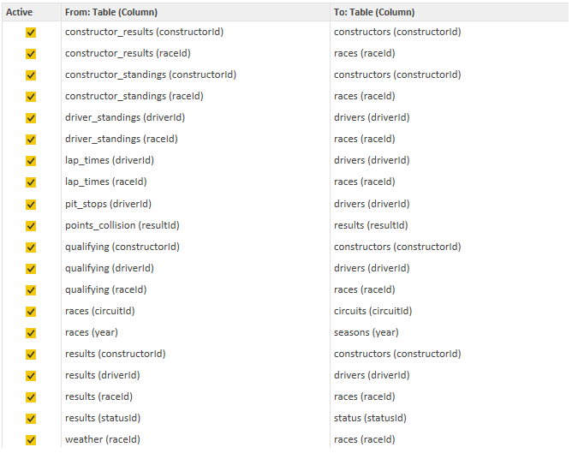
DATABASE SOURCE
A research was made for information that can be usable for these purposes, the characteristics of the data that could be used for the purposes of our project are the following:
Should be accurate.
Should be verifiable.
Should be diverse enough to perform our analysis.

Slide 11
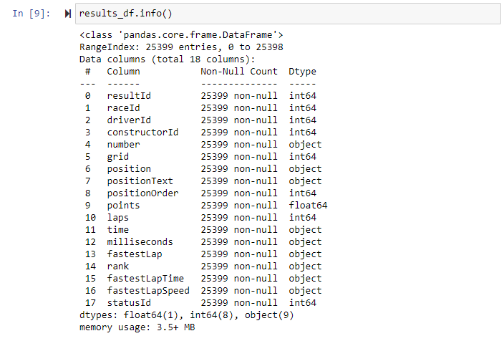
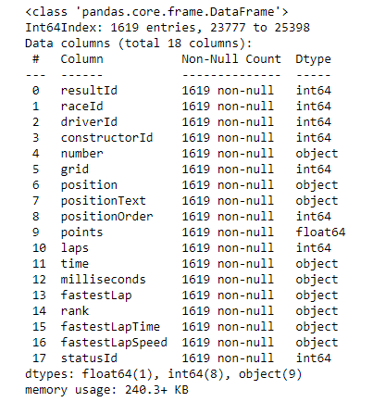
DATABASE EXPLORATION
Identify relevant databases.
Limit data from season 2018 to 2021 for comparation and processing purposes.
Perform preliminary data analysis with 1619 observations.

Slide 12
DATABASE INTEGRATION PROCESS
CSV
AWS/S3
Google Colab
PG Admin SQL
AWS/RDS

Slide 13
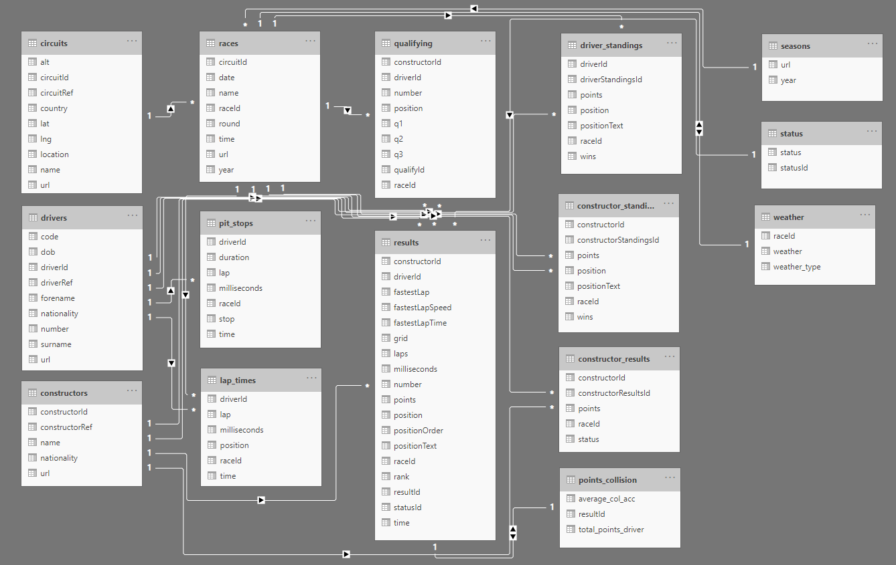
DATABASE INTEGRATION
This is the visual schema and the relationships all table have:

Slide 14
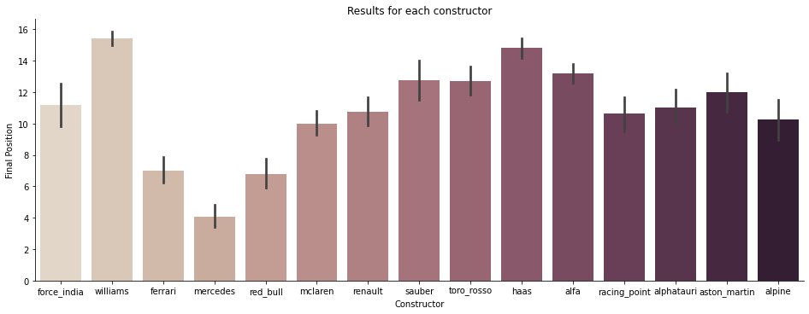
DATA EXPLORATION - PRELIMINARY ANALYSIS
The variable that give an answer to the study question is the column called positionOrder.
The most successful teams in the study period are Mercedes, Red Bull and Ferrari, while those that obtain the most negative results are Williams, Haas and AlfaRomeo.

Slide 15
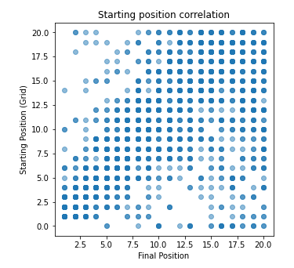
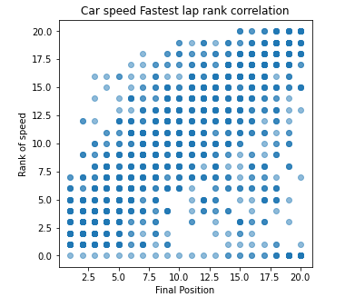
DATA EXPLORATION - PRELIMINARY ANALYSIS
Starting position(grid)/Final position correlation
Car speed/Final position correlation.

Slide 16
DESCRIPTION OF THE ANALYSIS PHASE OF THE PROJECT (MACHINE LEARNING MODELS)

Slide 17
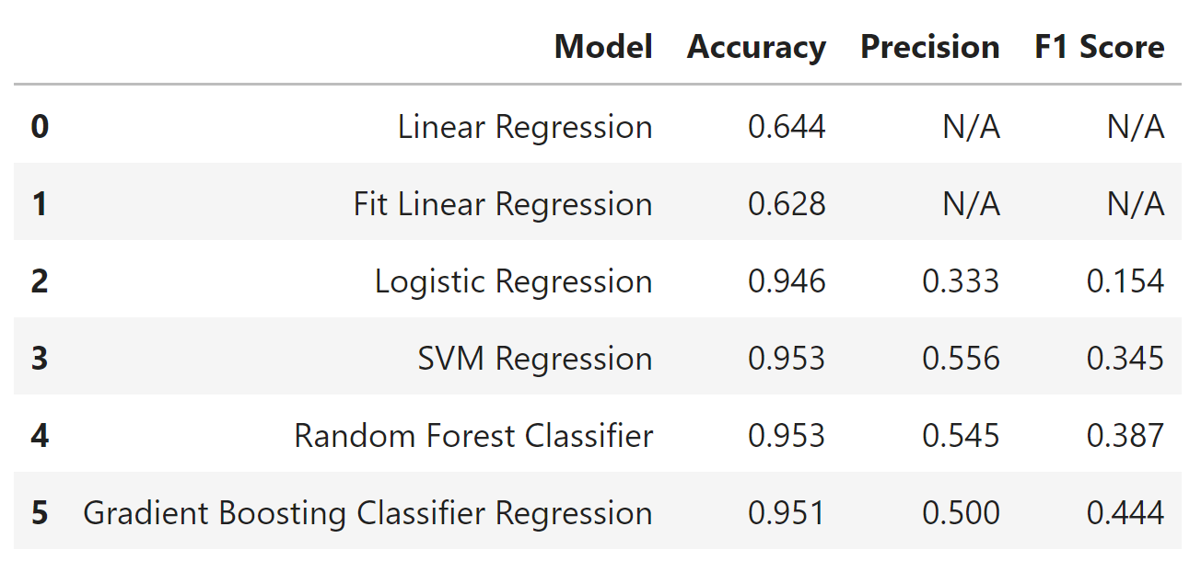
MACHINE LEARNING MODELS
Supervised machine learning model could deal with the research question, as the database have a column result with the final position for every race.

Slide 18
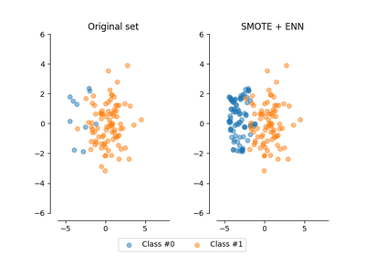
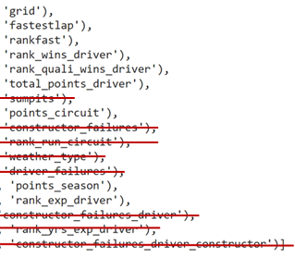
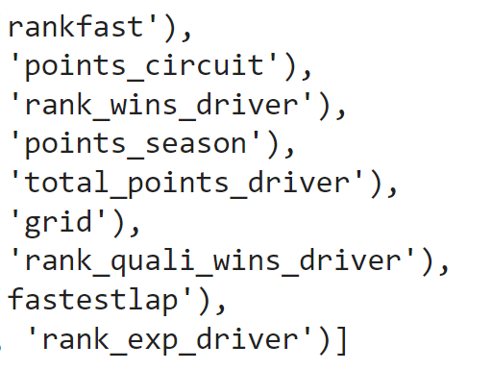
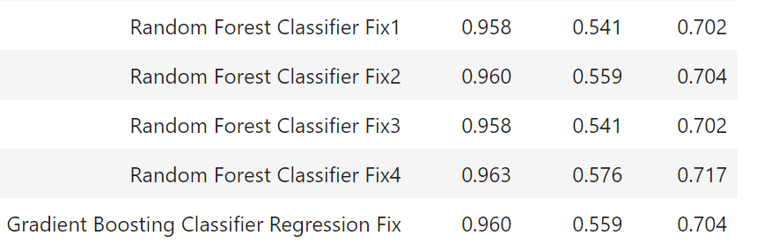
MACHINE LEARNING MODELS IMPROVEMENTS
Variable reduction
SMOTEENN technique
17 variables
9 variables
Final models

Slide 19

RESULTS OF ANALYSIS
Driver comparison
Constructor comparison
Different driver same test car
Same driver different test car
Driver | Test Car | Real Car | Win Prediction | Win Real
Max Verstappen | Mercedes | Red Bull | 39 | 15
Sergio Perez | Mercedes | Red Bull | 0 | 1
Charles Leclerc | Mercedes | Ferrari | 1 | 2
Esteban Ocon | Mercedes | Alpine | 0 | 1
Driver | Test Car | Real Car | Win Prediction | Win Real
Lewis Hamilton | Red Bull | Mercedes | 59 | 41
Lewis Hamilton | Mclaren | Mercedes | 4 | 30
Lewis Hamilton | Alfa Romeo | Mercedes | 0 | 30
Lewis Hamilton | Williams | Mercedes | 0 | 30
40 | 19
63 | 131
More wins with test car (Mercedes)
Less wins with different test car

Slide 20
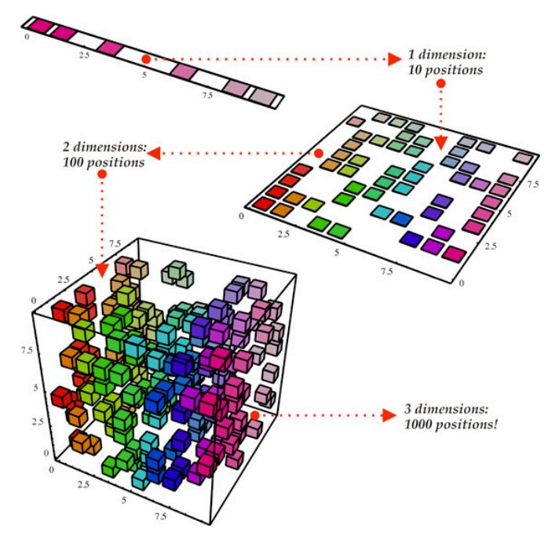
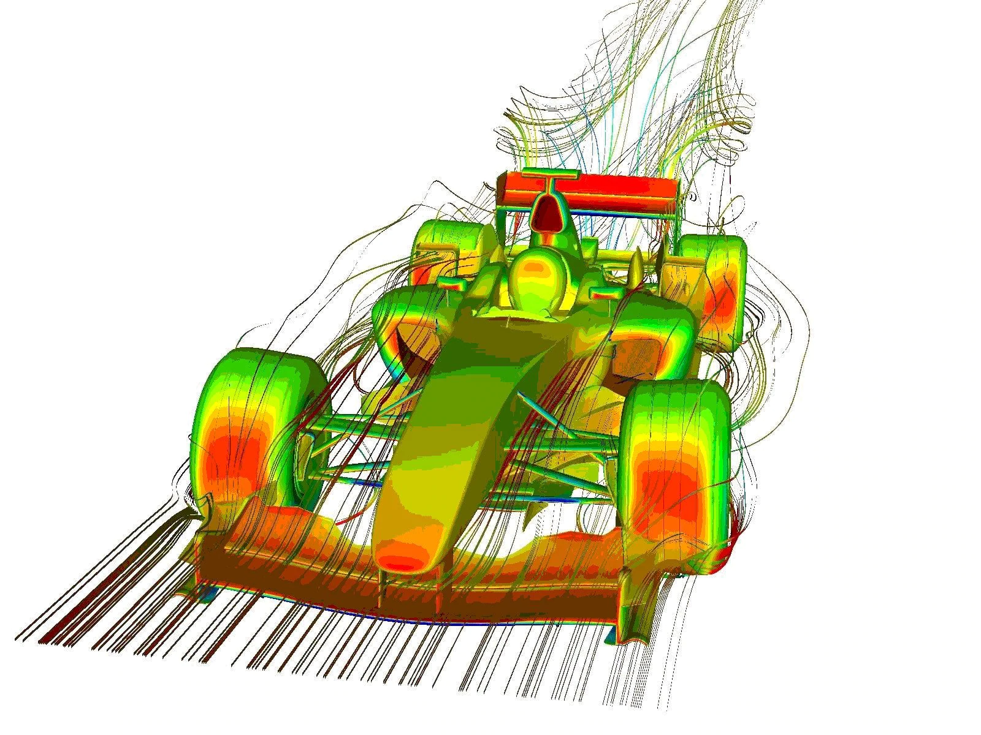
RECOMMENDATIONS FOR FUTURE ANALYSIS
Perform a Principal Component Analysis (PCA)
Add some others relevant variables as:
Car aerodynamics
Car temperature
Team strategy
Tyres use
Driver adaptation to the car
Investigations and development invest

Slide 21
VISUAL PRESENTATION AND DASHBOARDS

Slide 22

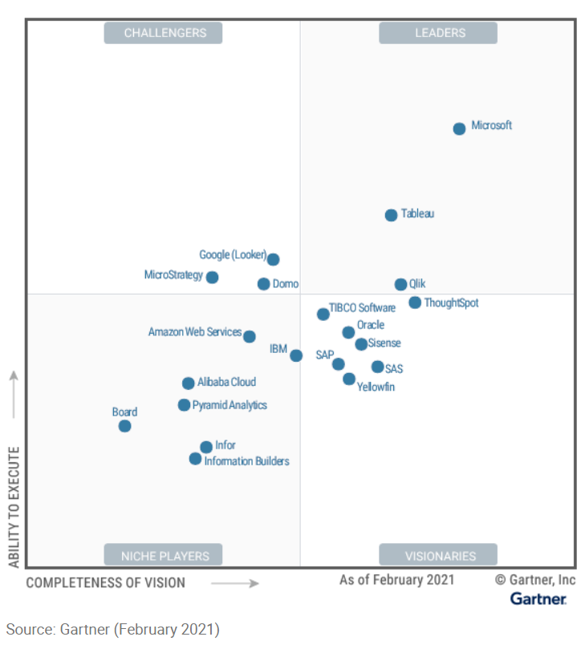
TABLEAU
Tableau is a visual analytics platform transforming the way we use data to solve problems—empowering people and organizations to make the most of their data.
Tableau is acknowledged as one of the leaders in industry to cover BI&A (Business Intelligence and Analytics) just behind Power BI as per Gartner 2021 magic quadrants for BI&A

Slide 23
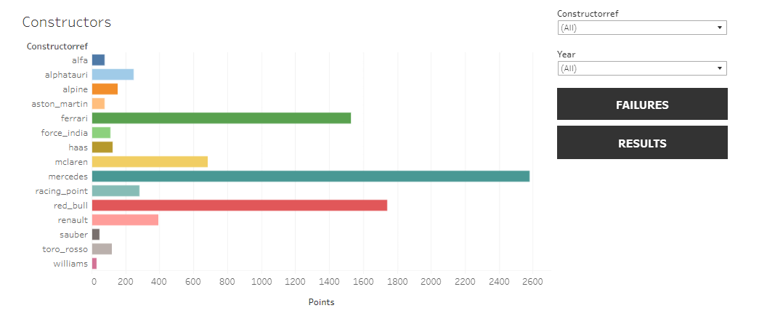

Slide 24
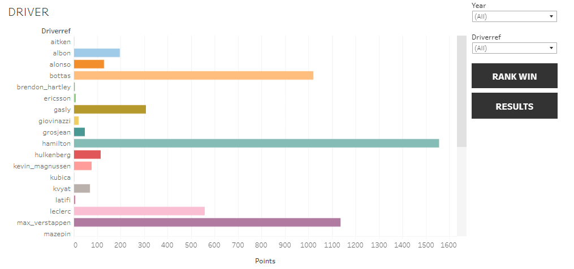

Slide 25
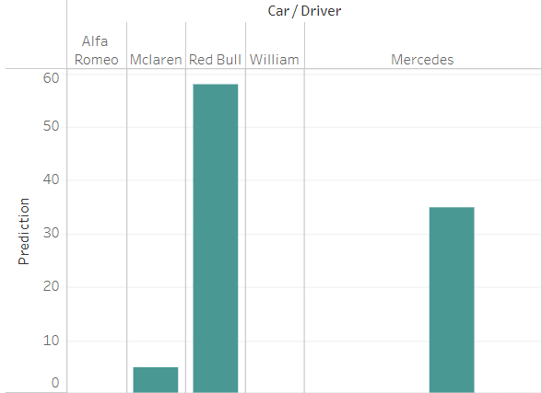
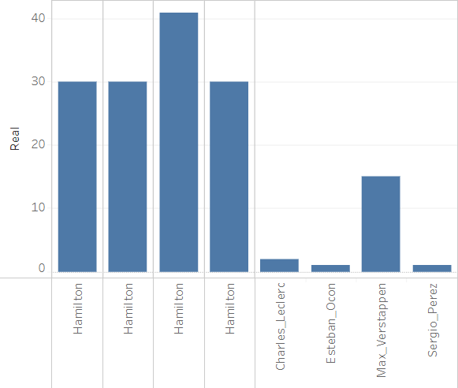
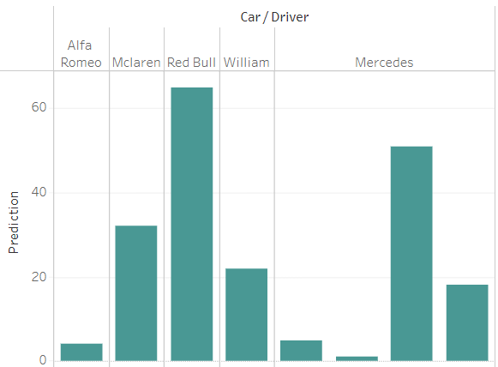
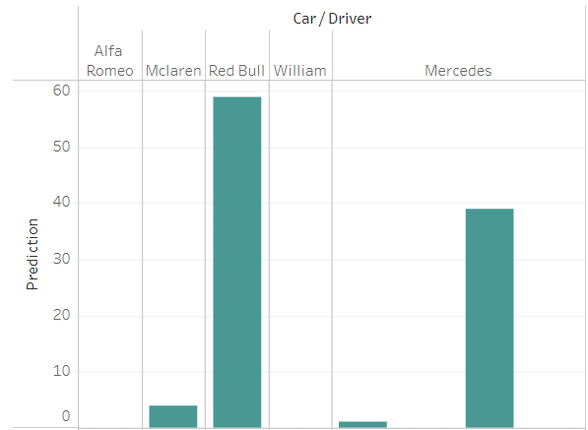
Graphic representation
Machine learning vs Real results

Slide 26
INTERACTIVE DASHBOARD
https://public.tableau.com/app/profile/raciel3899/viz/FINALPROJECT8/F1PROJECT?publish=yes

